Slide 1

C++ Workshop 3 Algorithms
Panagiotis Petridis
Brought to you by HackSoc

Slide 2
std::sort
Sorts elements in container
Uses a combination of quicksort and insertion sort.
Takes 2 iterators to a container and it will sort it from first to last
There’s also std::stable_sort that uses mergesort.
#include <algorithm>
#include <vector>
#include <iostream>
using namespace std;
int main() {
vector<int> v = {1,4,2,1,4,6,8,-10};
sort(begin(v), end(v));
for(int e : v)
cout << e << endl;
}
Link to reference

Slide 3
std::find
#include <algorithm>
#include <vector>
#include <iostream>
using namespace std;
int main() {
vector<int> v = {1,4,2,1,4,6,8,-10}; vector<int>::iterator it = find(begin(v),end(v), 4);
vector<int>::iterator ik = find(begin(v), end(v), 10);
cout << boolalpha;
cout << "4 is in the list: " << (it != end(v)) << endl;
cout << "10 is in the list: " << (ik != end(v)) << endl;
}
Searched a container for a specific element
Returns iterator to the position the element was found
Takes 3 parameters. 2 Iterators, first and last, and the value to search
Link to reference

Slide 4
std::remove
Removes all instances of an element in the container
Takes 2 iterators, first and last, and the value to remove
Returns iterator to the end of the new list of values
#include <algorithm>
#include <vector>
#include <iostream>
using namespace std;
int main() {
vector<int> v = {1,4,2,1,4,6,8,-10};
remove(begin(v), end(v), 4); vector<int>::iterator it = find(begin(v),end(v), 4);
cout << boolalpha;
cout << "4 is in the list: " << (it != end(v)) << endl;
}
Link to reference

Slide 5
std::remove_if
#include <algorithm>
#include <vector>
#include <iostream>
using namespace std;
int main() {
vector<int> v = {1,4,2,1,4,6,8,-10};
v.erase(remove_if(begin(v), end(v), [&](const int& i){
return i%2==0;
}), end(v));
vector<int>::iterator it = find(begin(v), end(v), 4);
vector<int>::iterator ik = find(begin(v), end(v), 2);
cout << boolalpha;
cout << "4 is in the list: " << (it != end(v)) << endl;
cout << "2 is in the list: " << (ik != end(v)) << endl;
}
Takes predicate P (can be lambda expression) and returns iterator to the elements to be removed
Need to use the erase function of the container for this one
Link to reference

Slide 6
std::for_each
Applies function to all elements in container.
Uses lambdas so function can even take parameters by reference and thus change the elements
Takes 3 parameters. 2 Iterators, first and last, and the function to be applied (usually a lambda)
#include <algorithm>
#include <vector>
#include <iostream>
using namespace std;
int main() {
vector<int> v = {1,4,2,1,4,6,8,-10};
for_each(begin(v), end(v), [&](const int& i){
cout << i << " ";
});
cout << endl;
}
Link to reference

Slide 7
std::min_element / std::max_element
Returns iterator to the maximum/minimum element in array
Can take custom predicate to use as a compare function (usually a lambda)
Takes 2 iterators first and last and finds the element in that range
#include <algorithm>
#include <vector>
#include <iostream>
using namespace std;
int main() {
vector<int> v = {1,4,2,1,4,6,8,-10};
vector<int>::iterator it = min_element(begin(v), end(v));
cout << "Minimum value is: " << *it << endl;
}
Link to reference(min)
Link to reference(max)

Slide 8
Writing our own algorithms
We will write a map-reduce algorithm that takes 2 iterators, first and last and 2 functions map and reduce and performs the map-reduce operation.
We will make it work with any kind of STL container and with any data type.
The point of the algorithms is to be as generic as possible and that’s what we will focus on.

Slide 9
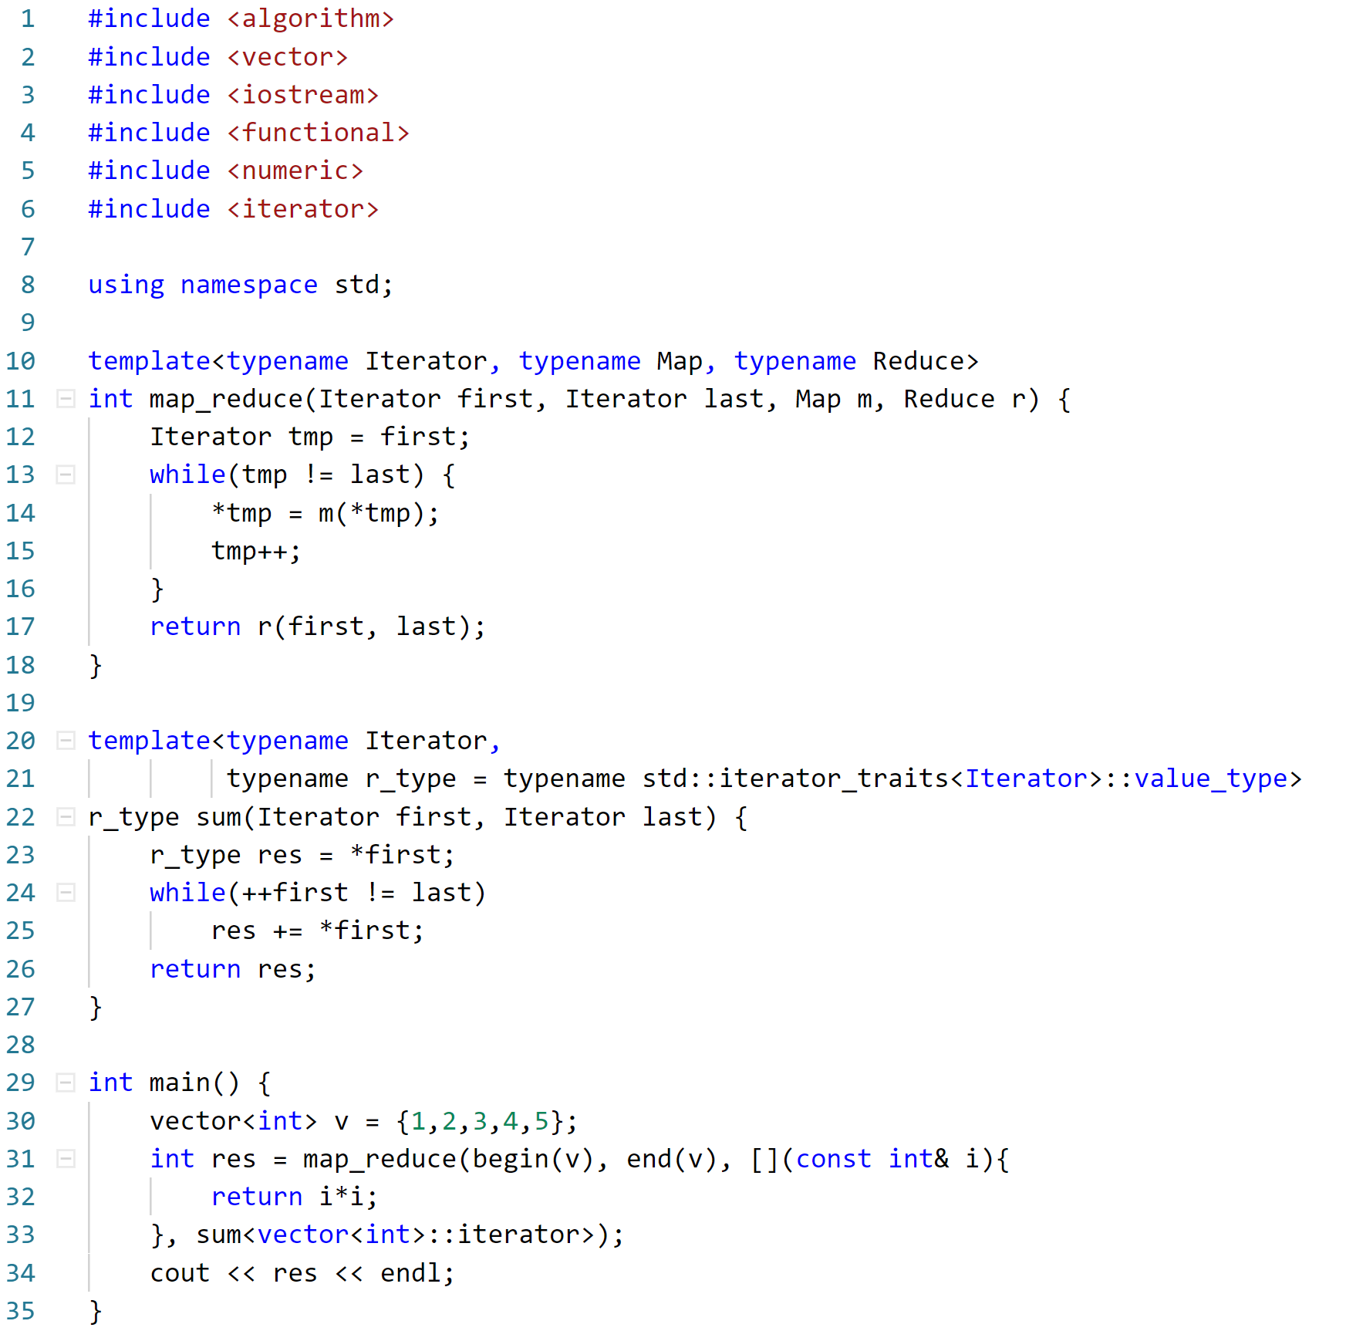
Our Map-Reduce function
Gives value type of iterator
Lambda expression
Need to pass template parameters!

Slide 10
Practice! https://www.hackerrank.com/ Resources https://github.com/PanagiotisPtr/cpp_workshop
Thank you for attending the workshops!

